Slide 1
Week 4. Modeling In Practice
A. Michelle Lawing, PhD
Associate Professor
Paleobiology, Evolution, and Climate Lab
Ecology and Conservation Biology
Texas A&M University
alawing@tamu.edu

Slide 2
Welcome, hello, any announcements?

Slide 3
Project Milestones
Date | Milestone
Sept. 11 | Project topic
Oct. 2 | Data plan
Oct. 23 | Modeling plan
Nov. 6 | Preliminary results
Dec. 1 (optional) | Full final draft due
Dec. 1 (redefined day) Dec. 10 1-3 pm (finals slot) | Presentation
Dec. 11 | Final paper

Slide 4
Class Plan
Today: Writing, discussion, lecture on Modeling In Practice (Peterson 4 and 5)
Thursday: Lab 03 due this Friday before midnight

Slide 5
Write to yourself (2-minute paper)
What is a species geographic distribution?
What is an ecological niche?
What is the difference between species distribution modeling and ecological niche modeling?

Slide 6
Purpose of modeling - “fit for purpose”
Why do you want to build a model in the first place?
Do you want an explanation about why a species is living where it currently lives?
Do you want a current distribution map of the species?
Do you want to know where the species might find suitable conditions in another place or time?

Slide 7
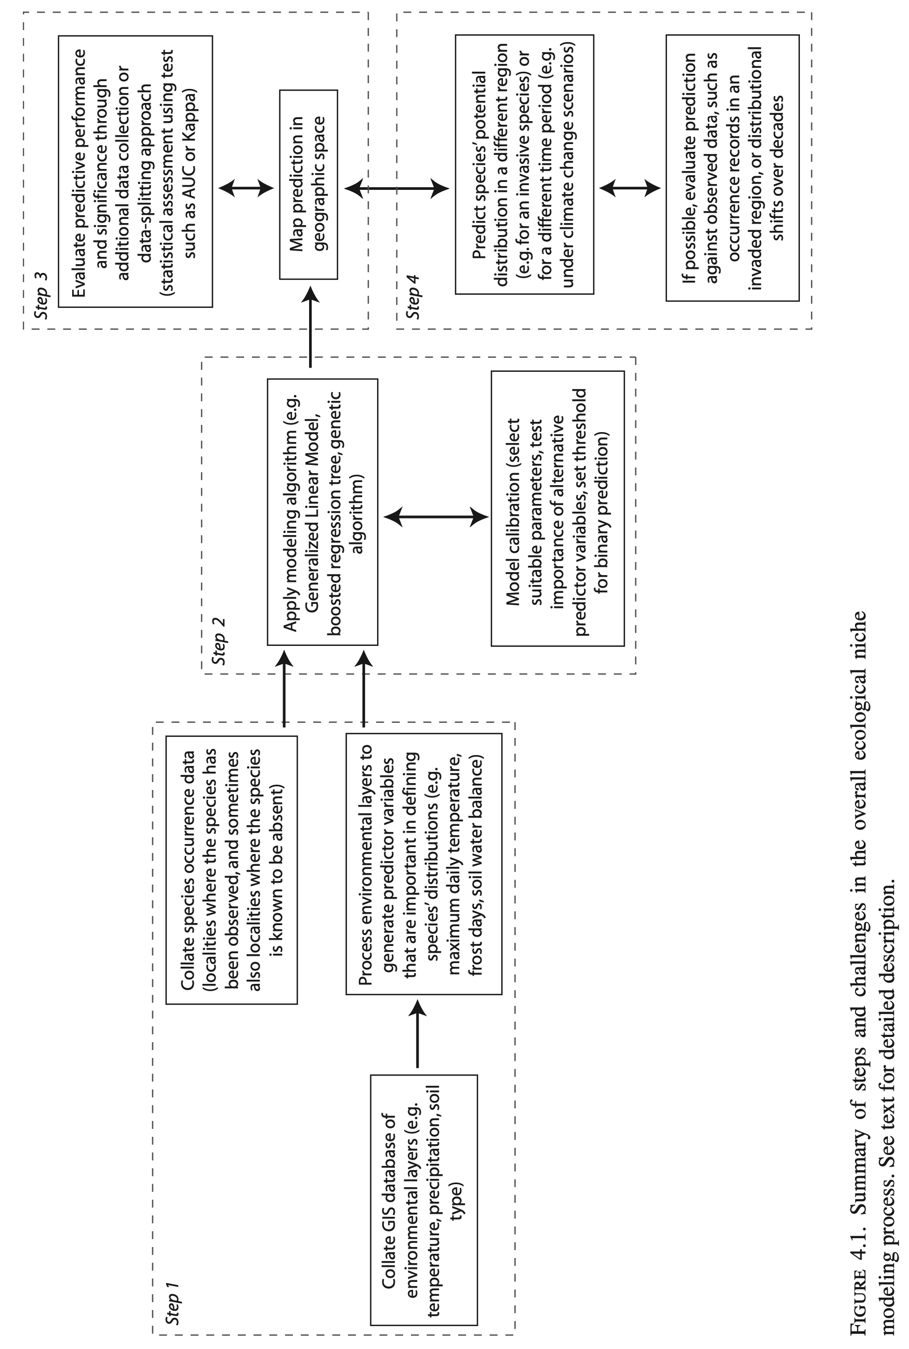
Step 2: Niche modeling
Step 3: Model projection and evaluation
Step 1: Data preparation
Step 4: Model transferability

Slide 8
Step 1.5: Identify bias, resampling, training and evaluation datasets
Step 1: Data preparation

Slide 9
Step 2: Niche modeling
<- Lots of Assumptions

Slide 10
Step 3: Model projection and evaluation
Step 4: Model transferability

Slide 11
What do these models estimate?
Suitability: relative compatibility with modeled conditions
Relative intensity: expected density of records relative to other locations
Occupancy probability: probability that the species occupies a site
Observation probability: probability of recording the species
Potential distribution: geographic projection of suitable conditions

Slide 12
Model evaluation terms
Evaluation: general term covering all forms of model assessment
Calibration: estimate the model using training data
Verification: assess fit to the calibration data
Validation: test predictions with independent data
Cross-validation: test predictions with partial independence, depending on how folds are constructed

Slide 13
Loss functions
A loss function defines the cost of prediction errors
Omission error predicts absence where the species occurs
Commission error predicts presence where the species does not occur
The appropriate balance of these depends on the biological or management objective

Slide 14
Geographic and environmental representation
G-space bias: observations cluster in particular locations
E-space bias: observations fail to represent available environmental conditions
Geographic clustering does not necessarily produce environmental bias
Both forms of bias should be evaluated

Slide 15
Transferability
Geographic transfer applies a model to another place
Environmental extrapolation provides predictions under conditions that are outside the calibration data
Map environmental novelty and the model’s area of applicability
Treat predictions outside that area as weakly supported

Slide 16
Step 5: Ecological interpretation
Translate model output into a biological claim
Distinguish conclusions supported directly by the data from conclusions that depend on assumptions
State whether the model supports interpretations such as explanation, mapping, or transfer
Consider accessibility, detection, equilibrium, scale, and missing variables

Slide 17
Step 6: Simulation-based robustness of ecological interpretations
Simulate plausible ecological and observation processes and any other plausible assumptions made during the modeling process, rerun the complete modeling workflow, and determine which biological conclusions remain stable.
Ecological: niche shape, accessibility, dispersal
Observation: sampling effort, detection, location error
Analytical: spatial grain, background selection, model complexity
Transfer: novel environments and future scenarios

Slide 18
Step 6: Simulation-based robustness of ecological interpretations
Vary assumptions: accessible area and dispersal, niche shape, sampling effort, detection, locational error, spatial grain, background selection, model complexity, and novel environments
Run the same workflow: use the same predictor-selection rules, model settings, validation design, and interpretation procedure
Compare interpretations: response-curve shape, direction of effects, variable ranking, predicted range area, priority locations, and any biological interpretation coming from the output

Slide 19
Robustness of interpretations
Stable: substantively unchanged across plausible scenarios
Conditional: valid only under specified assumptions
Not robust: disappears or reverses under plausible alternatives

Slide 20
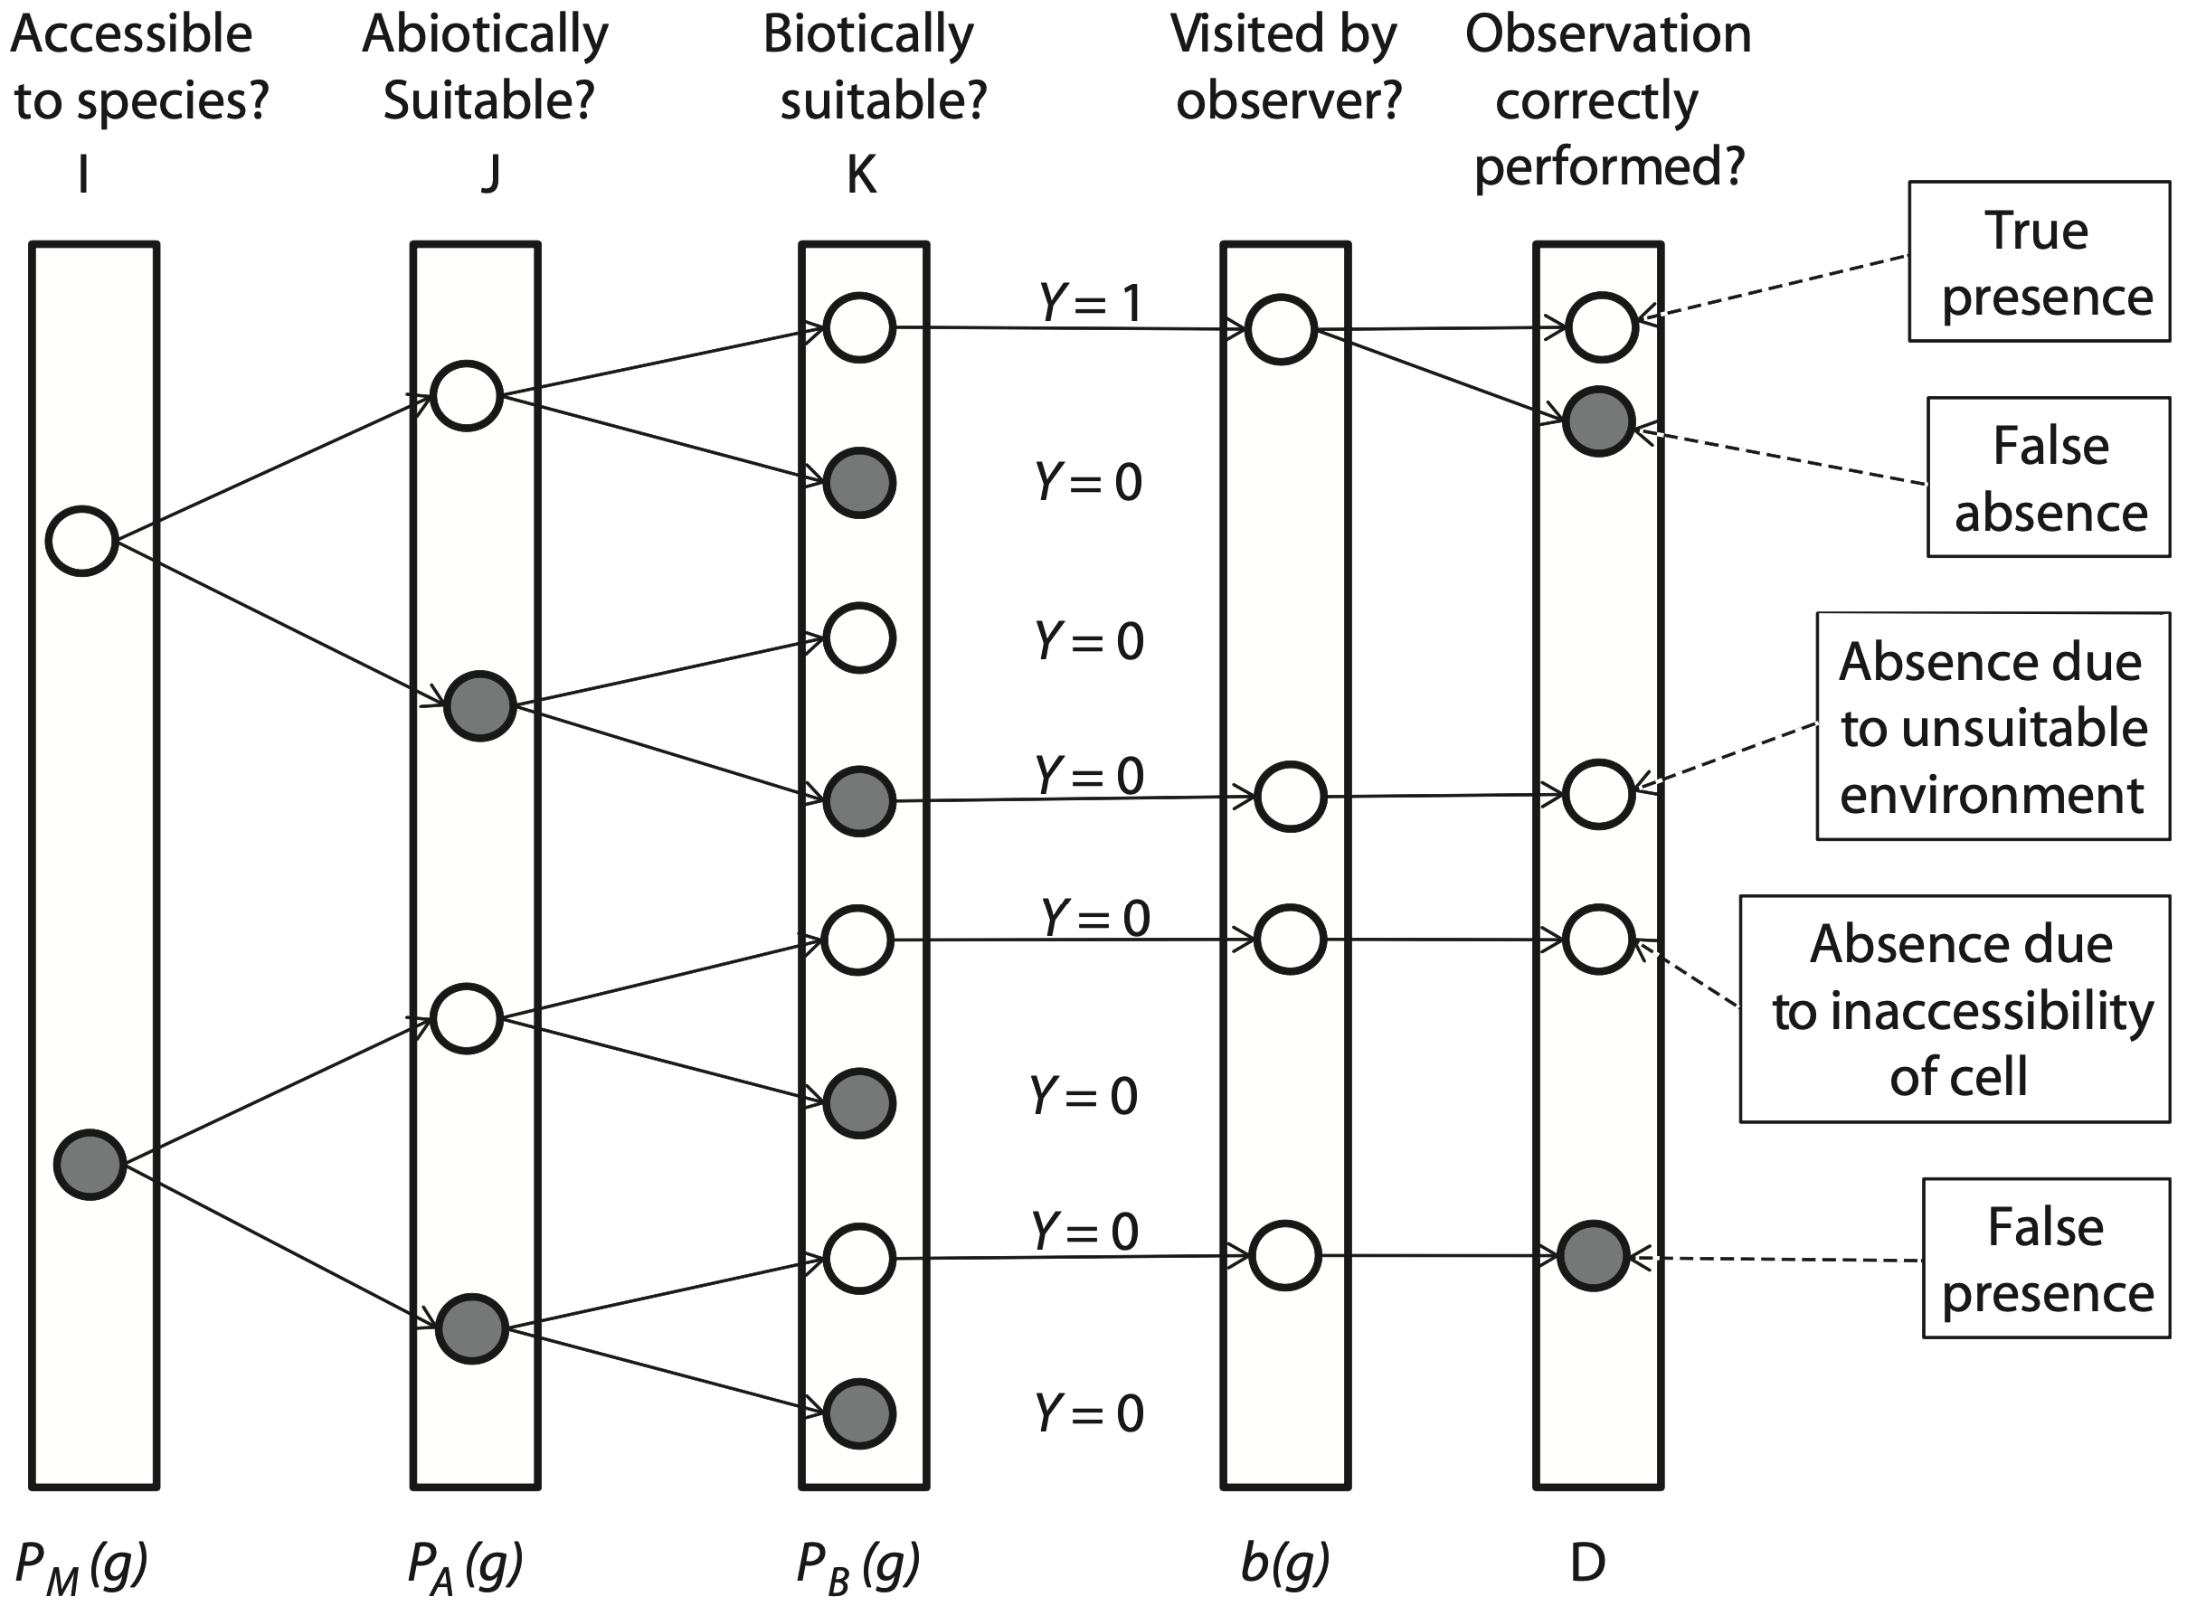
Peterson’s occurrence probability tree
Ecological state: suitability, occupancy, abundance, dispersal
Observation process: where people sampled, sampling effort, detection, identification, and reporting

Slide 22
Ecology

Slide 23
Observable

Slide 24
Detectable

Slide 26
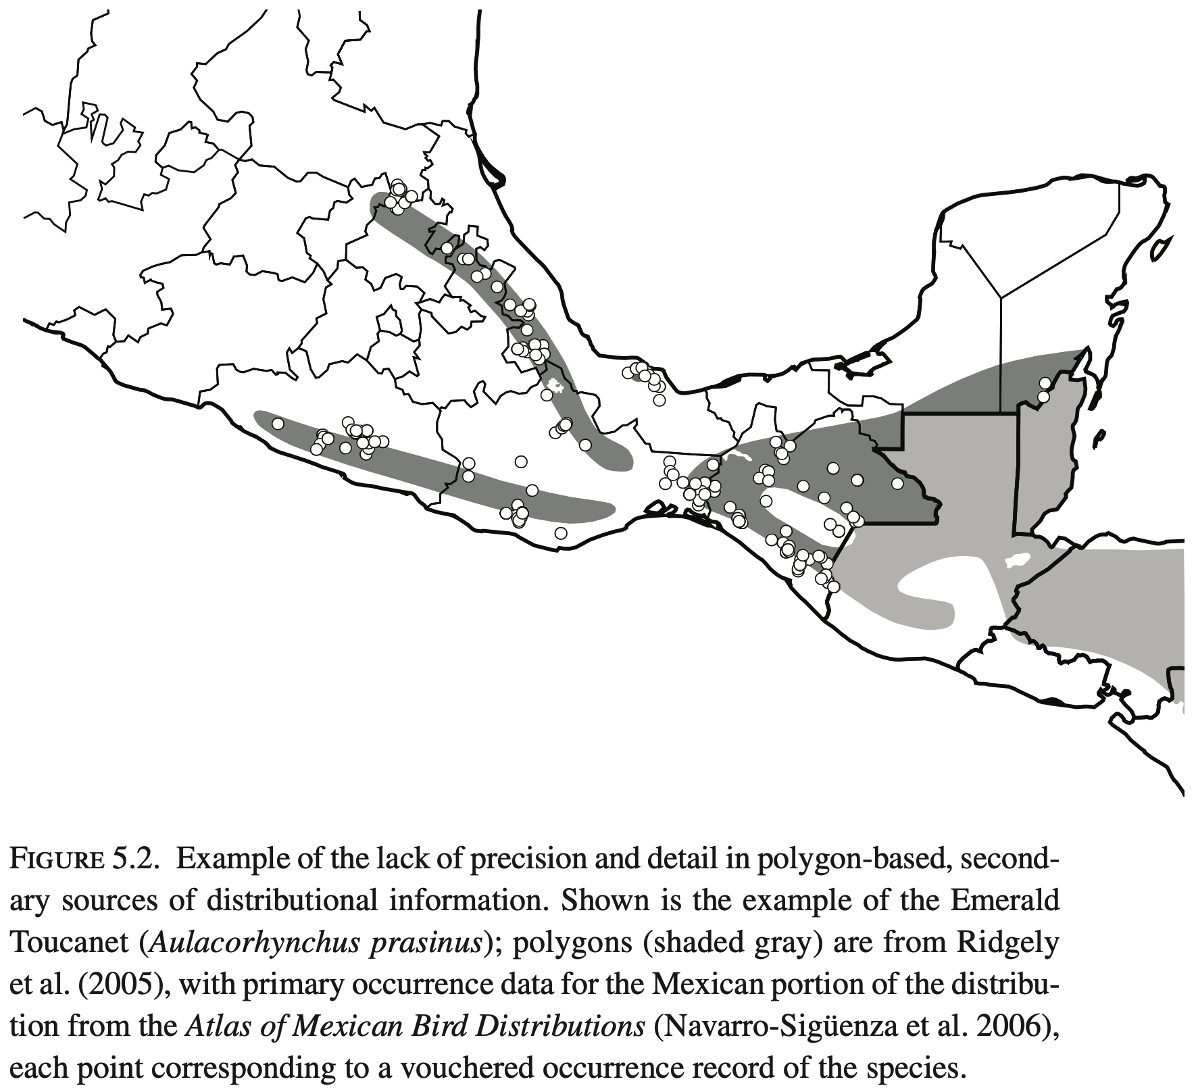
Primary and secondary occurrence data
Primary: places species at specific location and time
  Vouchers: occurrence points that can be verified or revisited
    specimens, photographs, audio recordings
Secondary: range maps
  involves some interpretation by creator
  may not represent full extent of primary occurrence points

Slide 27
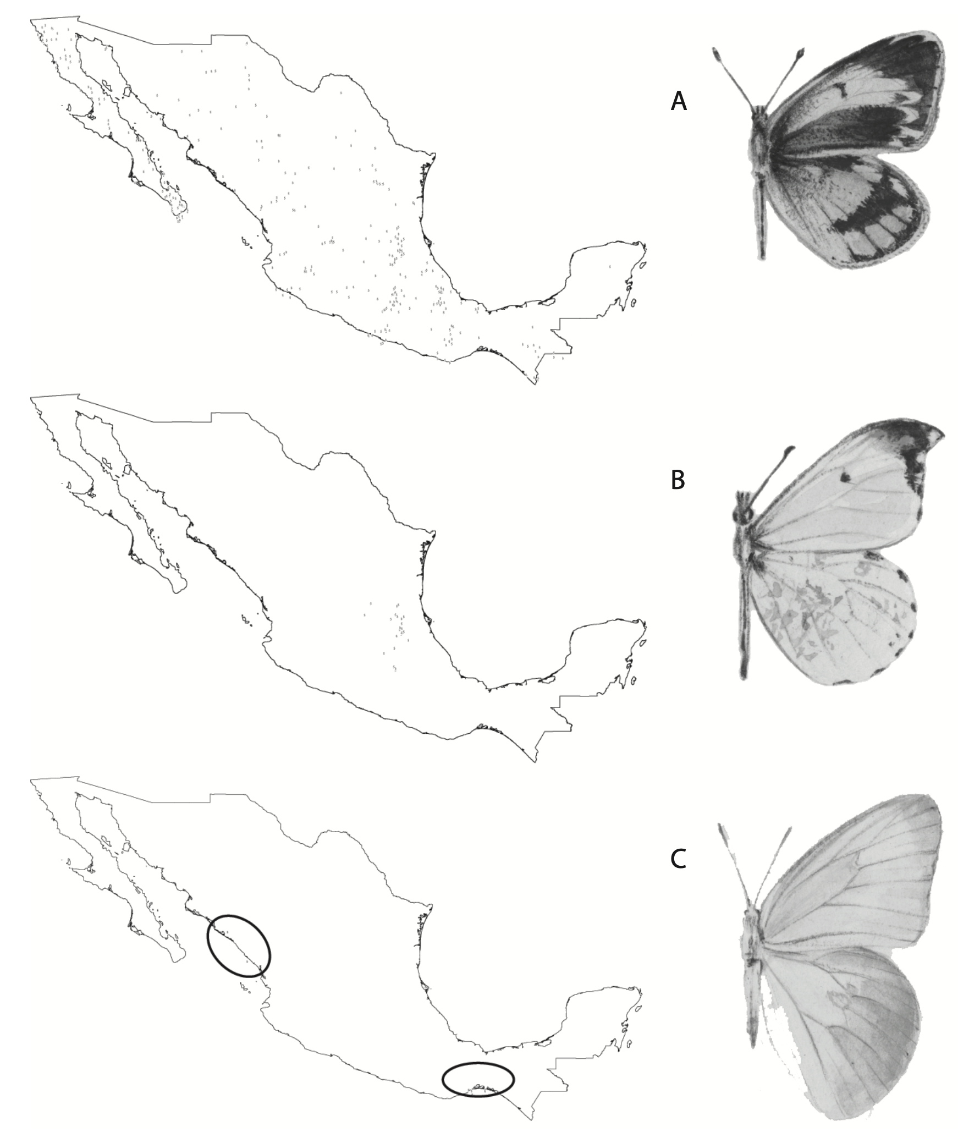
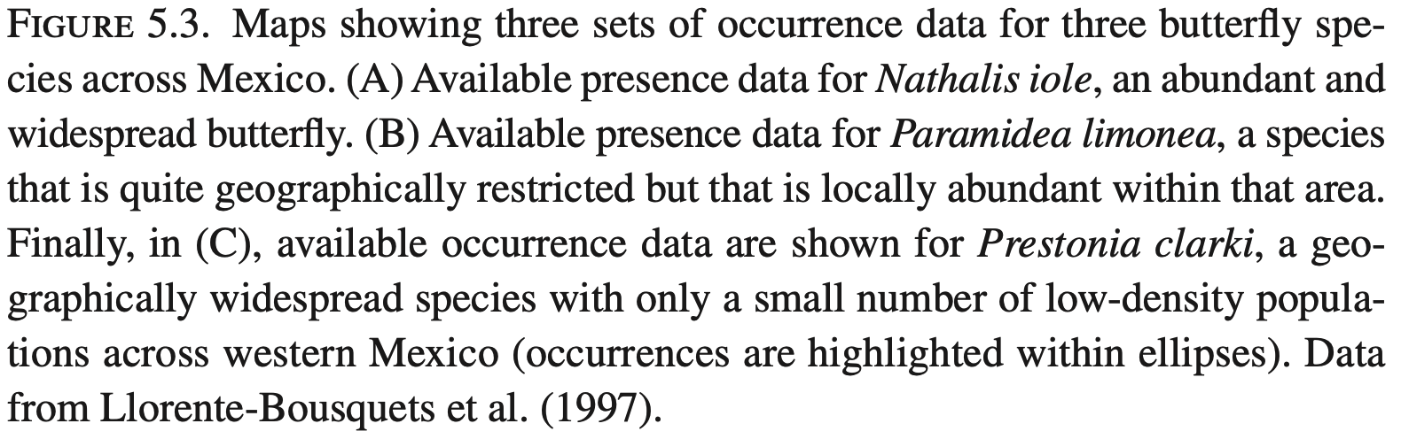
Ranges and rarity
Rabinowitz et al. (1986)
  3 axes of rarity
    population size
    occupied distribution area
    habitat specificity
Different causes of rarity will influence occurrence data

Slide 28
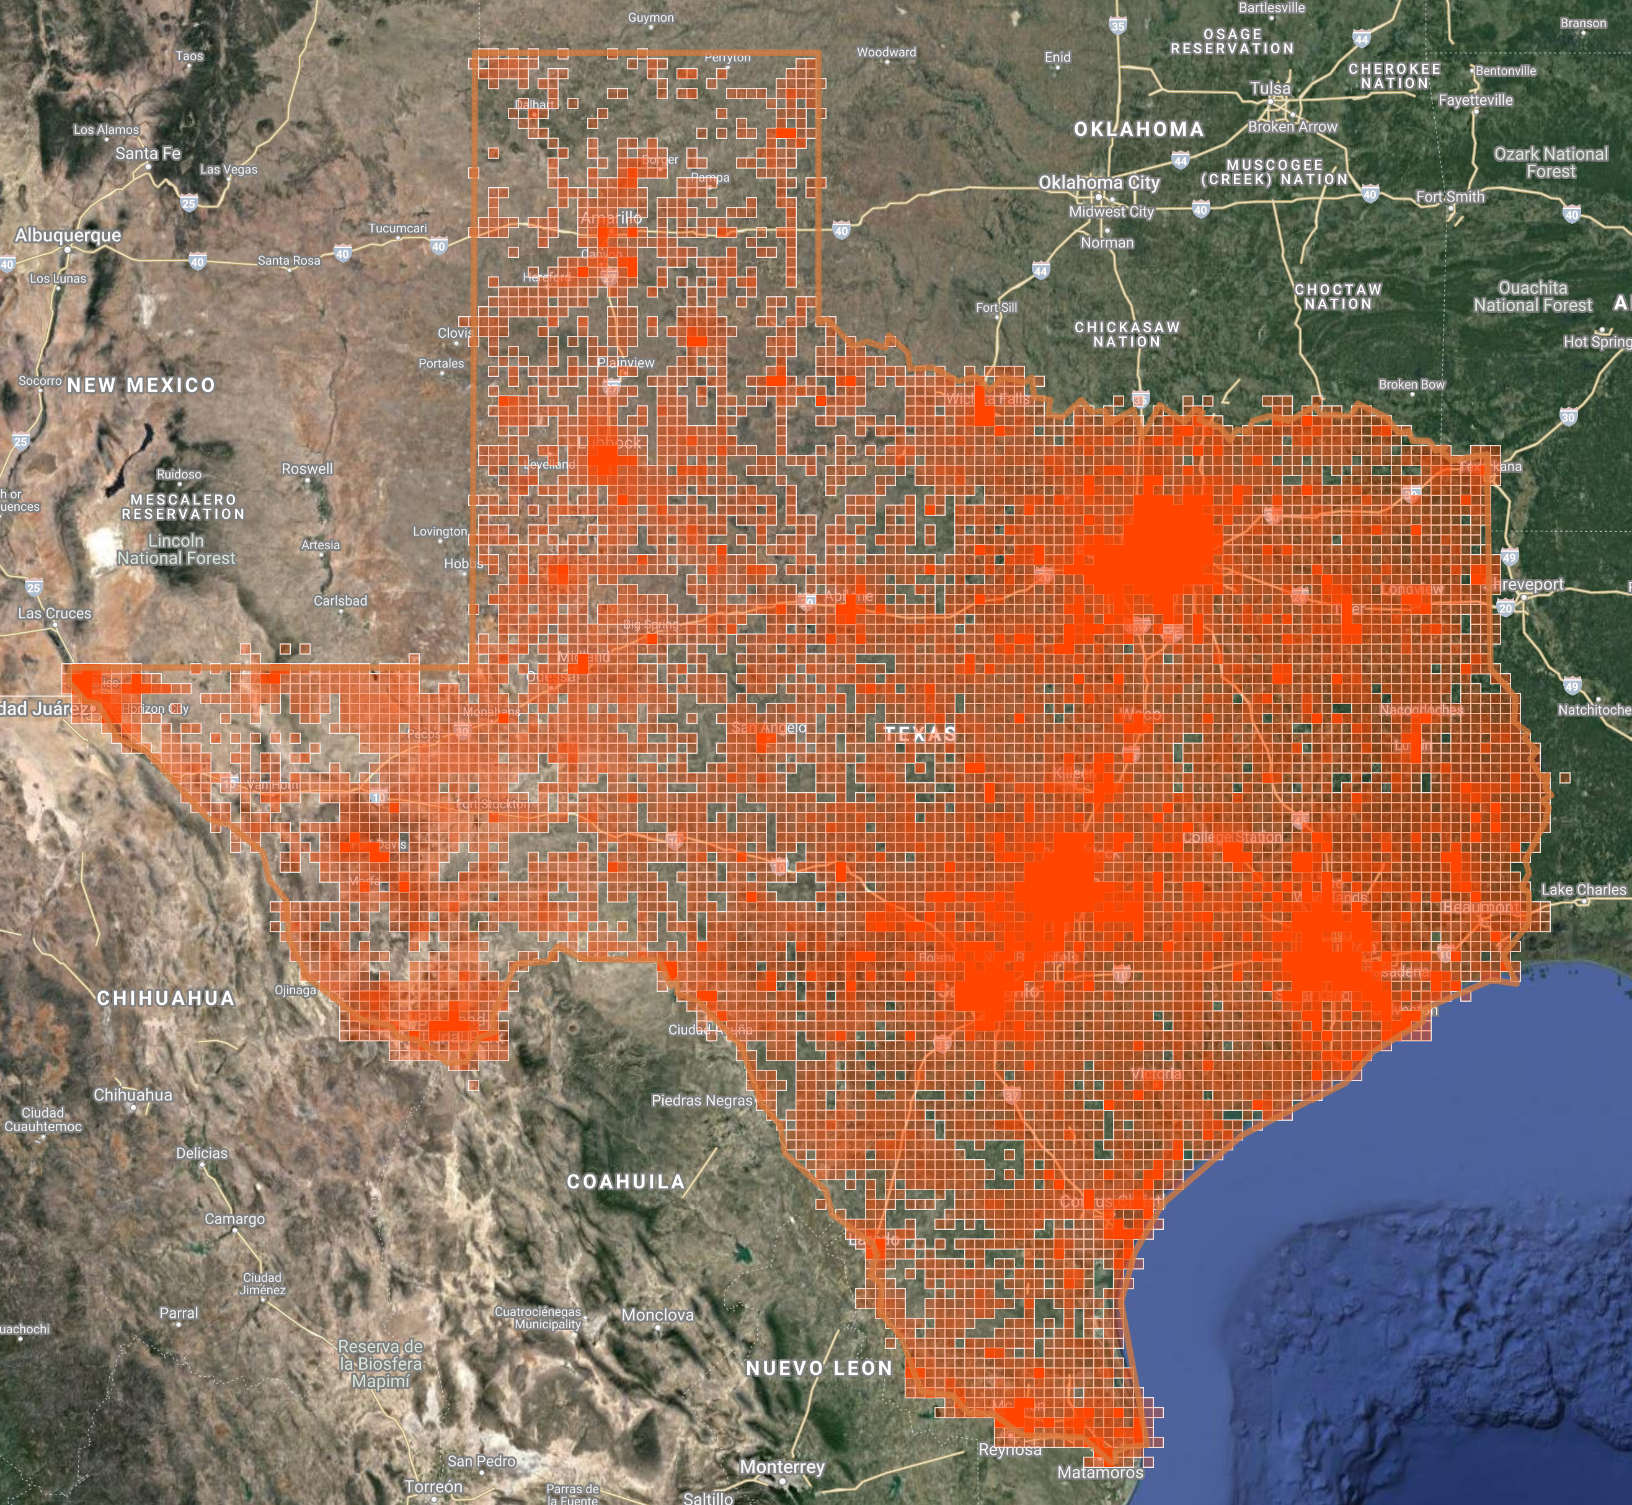
Sampling bias
sampling subset of environmental space
access
  road bias
sampling effort
  urban centers
  citizen science
different sources of data

Slide 29
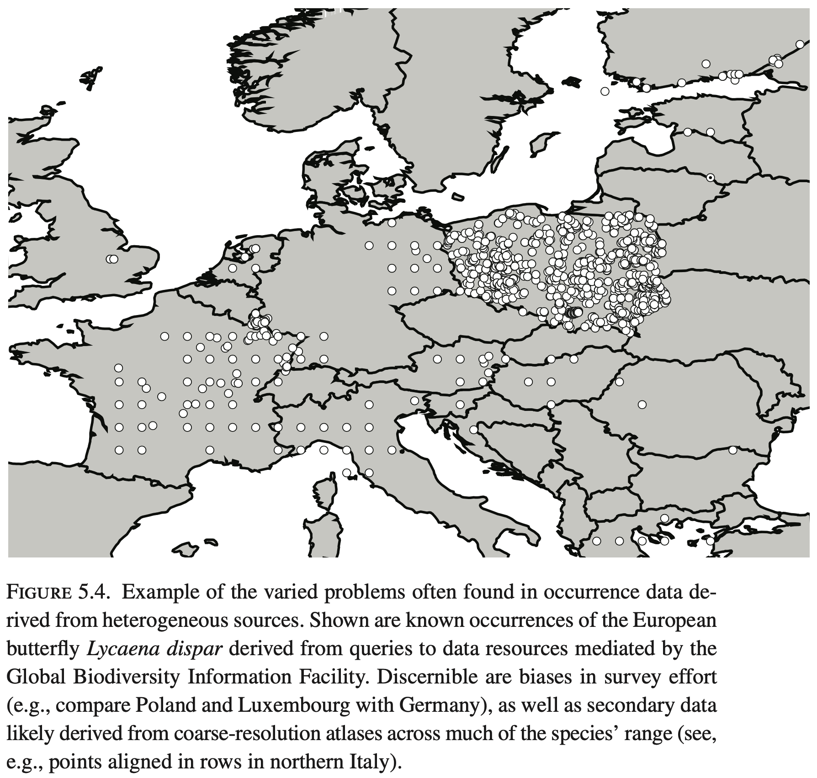
Sampling bias
sampling subset of environmental space
access
  road bias
sampling effort
  urban centers
  citizen science
different sources of data

Slide 30
“Real” absence data
Certain modeling methods require true absence data
Others generate pseudoabsence points
Absence data may be sampled from suitable habitat that species is unable to disperse to
Species may be present but undetected
“one is never sure that those sites are genuinely not habitable by the species, or rather may not hold the species simply because they lie outside of the species’ dispersal range, or the species was not present at the time of sampling owing to temporal differences in occupancy, or it was present in other unsampled parts of the cell” (p. 76)

Slide 31

Analog data in the digital age
Older specimens have vague locality data
Expand metadata
  specimen location, collector/IDer, spatial precision, species concept
Location uncertainty needs to be quantified or considered for data to be useful in modeling
A digitized specimen from
the S.M. Tracy Herbarium

Slide 32
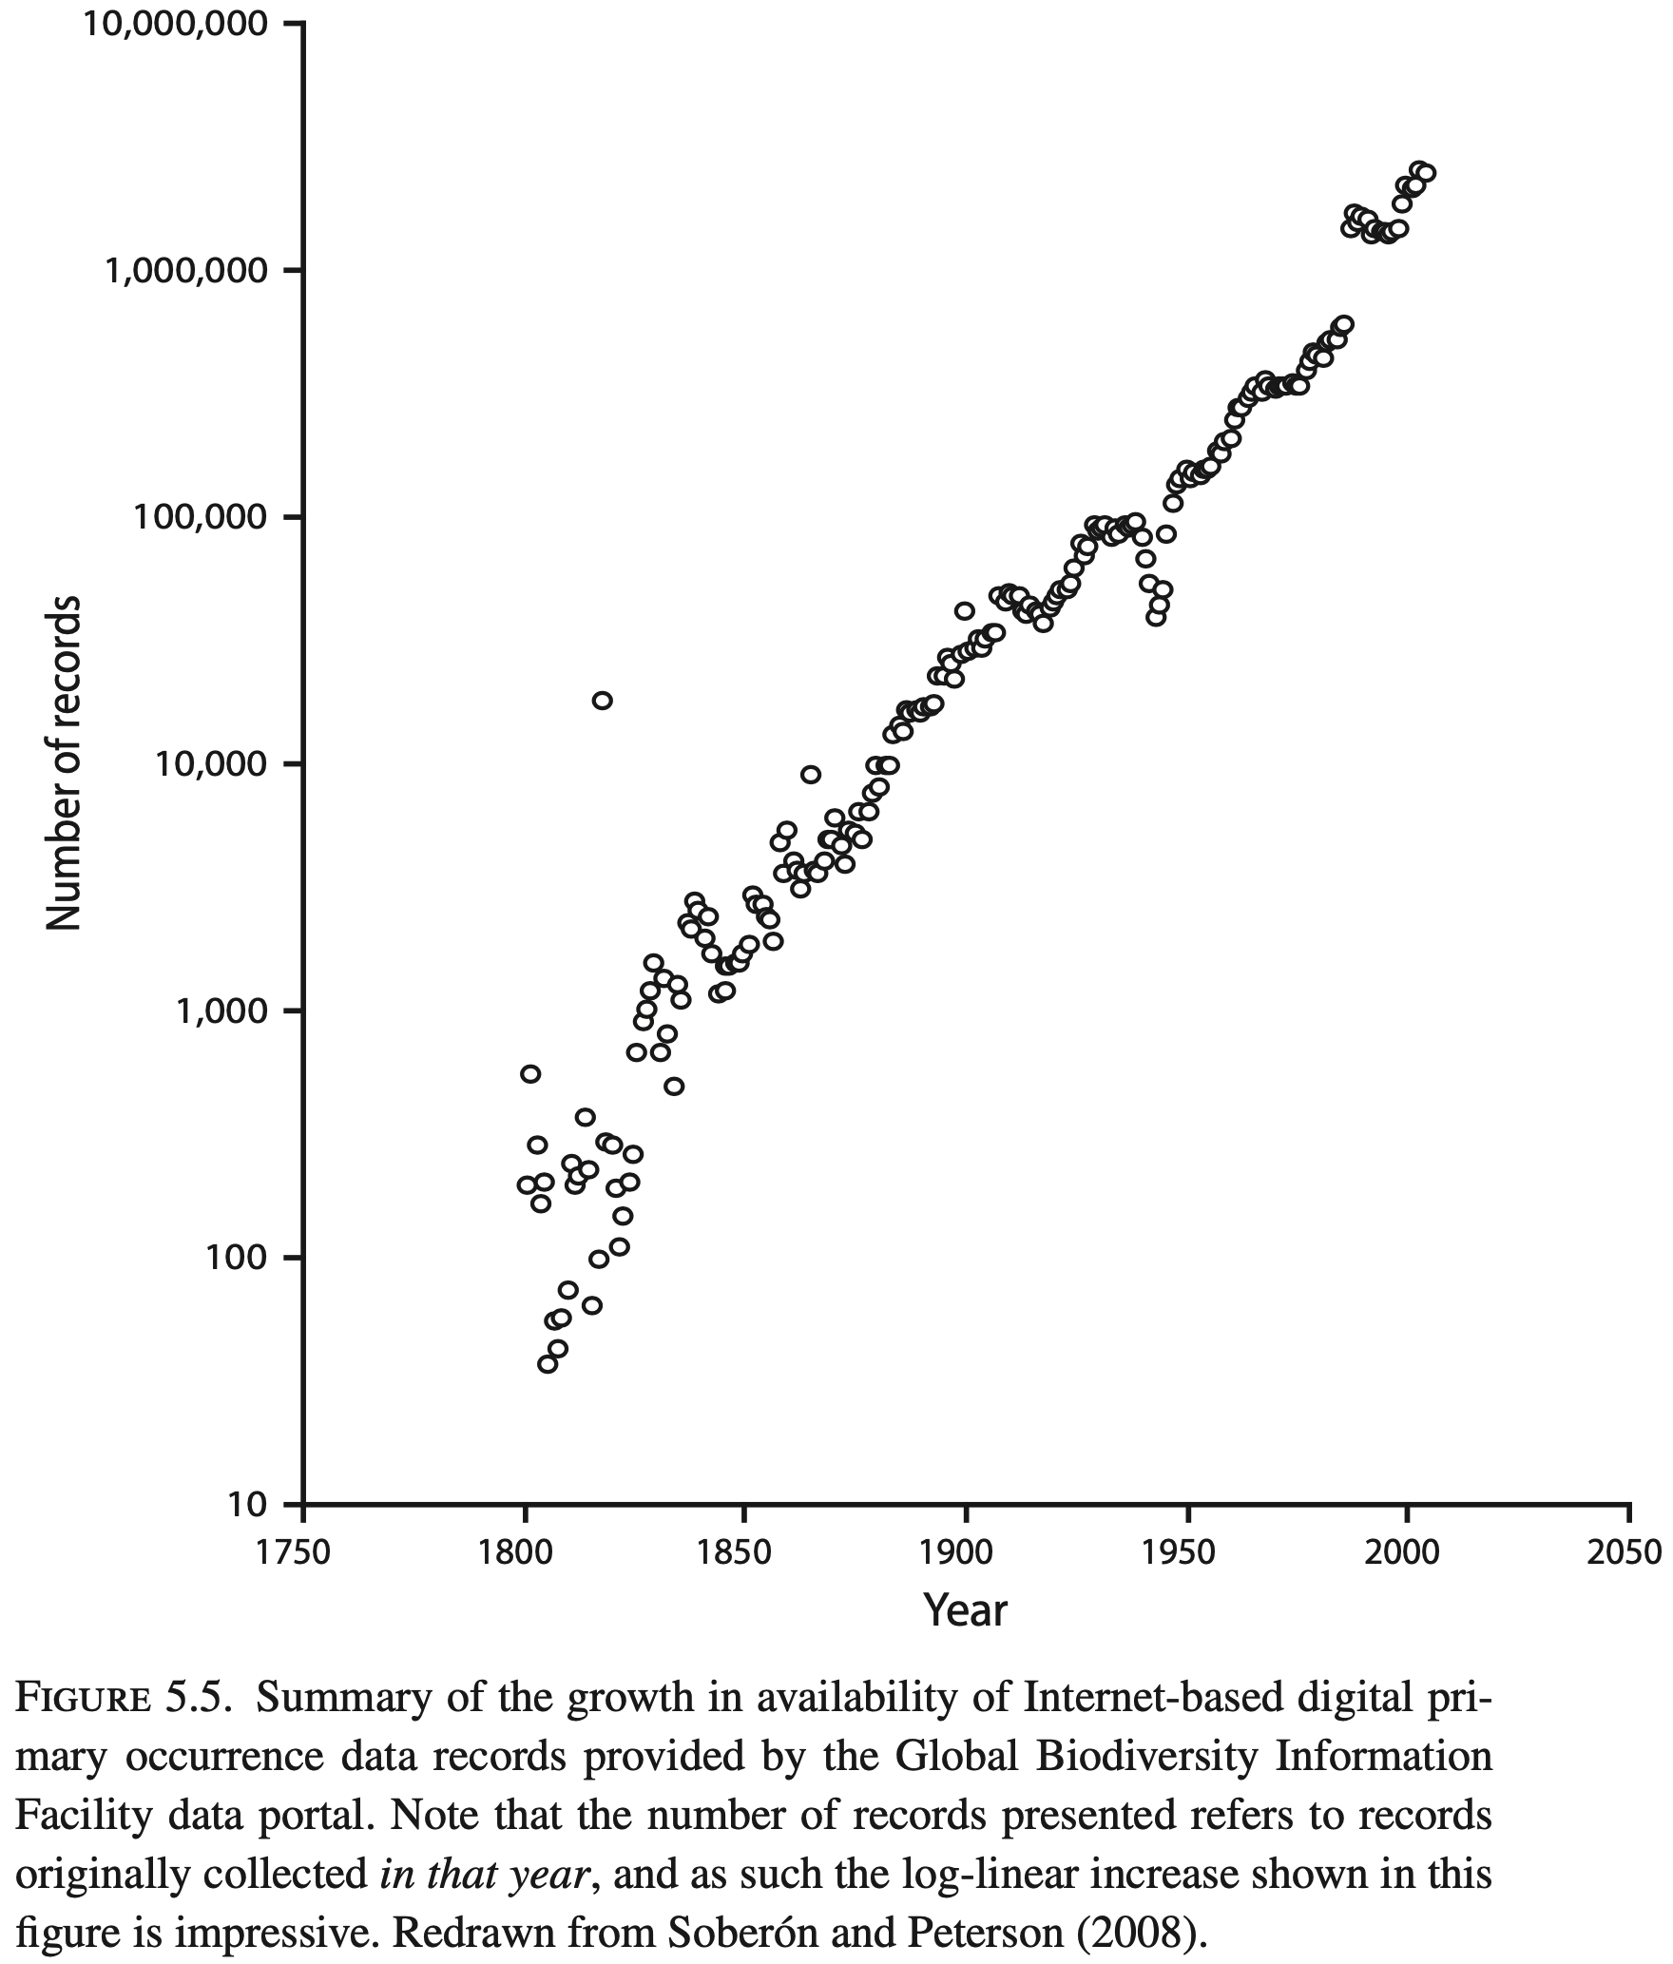
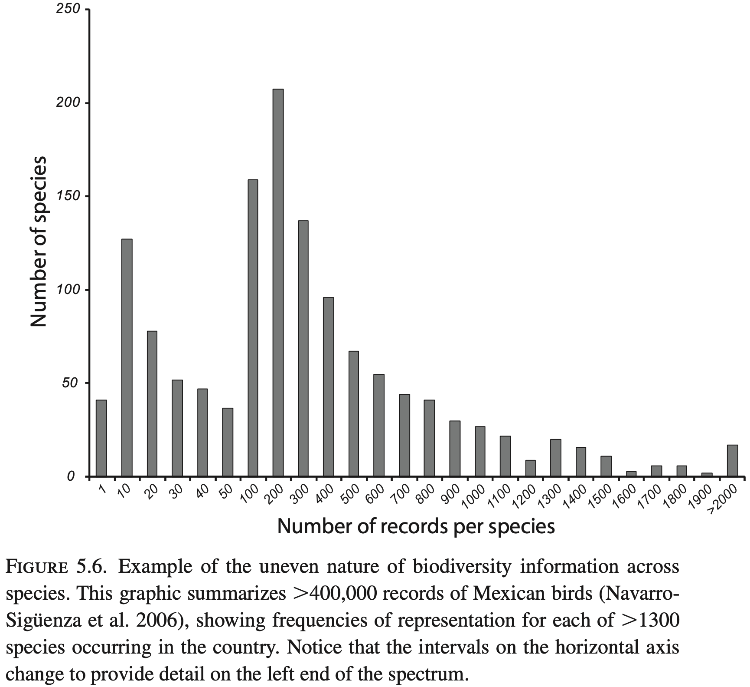
Availability of occurrence data has greatly increased over the last century, but not all species are represented evenly.

Slide 33
Observation data types
Presence-only: locations where the species was recorded
Background: environmental conditions available in the calibration region; not absences
Pseudoabsence: selected locations treated as absences during model fitting
Nondetection: a surveyed location where the species was not recorded
Repeated surveys can help separate occupancy from detection

Slide 34
Bias correction
Target-group background uses records of similarly sampled taxa to approximate observer effort
Bias covariates describe access, population density, roads, or sampling effort
Integrated models combine opportunistic records with structured surveys
Every correction method introduces assumptions that should be documented and tested

Slide 35
R tools for modeling

Slide 36
Libraries for Lab 03
library(sf) # vector spatial data
library(terra) # environmental rasters
library(blockCV) # spatial or environmental folds
library(ENMeval) # model tuning and evaluation
library(virtualspecies) # simulation-based robustness
library(CAST) # area of applicability

